Slide 1

TRR COLLEGE OF ENGINEERING
Department of CSE

Slide 2
DJANGO WEB FRAMEWORK
SOFTWARE METRICS MEASUREMENT USING RADON AND PYLINT
Under the guidance of
R. Vinod Kumar
Assistant Professor
by
BOREDA ANAND (16L01A0507)
A.ANIL KUMAR (16L01A0501)
SYED MOIZUDDIN (16L01A0546)
M.YASHWANTH (16L01A0525)

Slide 3
LIST OF CONTENTS
Introduction
Feasibility Study
Analysis
Design
Implementation
Testing
Output screens
Conclusion
Future enhancement
References
TRR College of Engineering

Slide 4
INTRODUCTION
Django framework is a compact Python framework intended for quick development
we will find out software metrics for Django using Radon that provides cyclomatic complexity raw metrics that consists SLOC, comment lines, number blank lines, Maintainability Index and Halstead metrics, also use Pylint
Pylint is a source code analyzer that finds for errors in programming, assists to use a coding standard strictly.
TRR College of Engineering

Slide 5
FEASIBILITY STUDY
TRR College of Engineering

Slide 6
FEASIBILITY STUDY
Business proposal is put forth with a very general plan for the project and some cost estimates
Requirements :
Economical feasibility
Technical feasibility
Social feasibility
TRR College of Engineering

Slide 7
FEASIBILITY STUDY
Economic study : carried out to check the economic impact that the system will have on the organization
Technical study : carried out to check the technical feasibility, that is, the technical requirements of the system
Social Feasibility: study is to check the level of acceptance of the system by the user
TRR College of Engineering

Slide 8
ANALYSIS
TRR College of Engineering

Slide 9
EXISTING SYSTEM
Flask framework is a Python micro-framework with a moderate approach and powerful by itself. Flask perfect for stand-alone applications and rapid prototyping.
Pyramid known as Pylons is a framework that gives reproducibility with NoSQL integration. Pyramid best for APIs, prototyping, and extensive web apps, like content management systems development.
Tornado is an event-based, non-blocking Python web server and web application framework serve high-traffic volume. The Bottle is a light and simple microframework.
TRR College of Engineering

Slide 10
DISADVANTAGES
There will be times as a software developer when a programmer works on projects that do not have unit tests, a daily build, a mess of legacy spaghetti code
Lines of code (LOC) are the most simple indicators and warnings. A massive, complicated project will have hundreds of thousands of LOC and that normal if the project is well-managed.
TRR College of Engineering

Slide 11
PROPOSED SYSTEM
Django is a framework for web development using python and created for the quick development of database driven sites
It focuses inefficiency, giving developer to do almost all tasks with as little coding effort as possible.
TRR College of Engineering

Slide 12
ADVANTAGES
LLOC: The variety of logical strains of code. Each logical line of code contains precisely one statement.
SLOC: The quantity of source lines of code. It does not relate to the LLOC.
LOC: The aggregate number of lines of code. It doesn't relate to the number of lines in the file.
Multi: The number of lines that represent multiline strings.
Comments: The number of comment lines. Multiline strings are not considered comment, to the Python, they are just strings.
TRR College of Engineering

Slide 13
MODULES
User
Admin
Django

Slide 14
HARDWARE REQUIREMENTS
System : Pentium IV 2.4 GHz.
Hard Disk : 40 GB.
Floppy Drive : 1.44 Mb.
Monitor : 14’ Colour Monitor.
Mouse : Optical Mouse.
Ram : 512 Mb.
TRR College of Engineering

Slide 15
SOFTWARE REQUIREMENTS
Operating system : Windows 7 Ultimate.
Coding Language : Python.
Front-End : Python.
Designing : Html, CSS, JavaScript.
Data Base : MySQL.
TRR College of Engineering

Slide 16
DESIGN
TRR College of Engineering

Slide 17
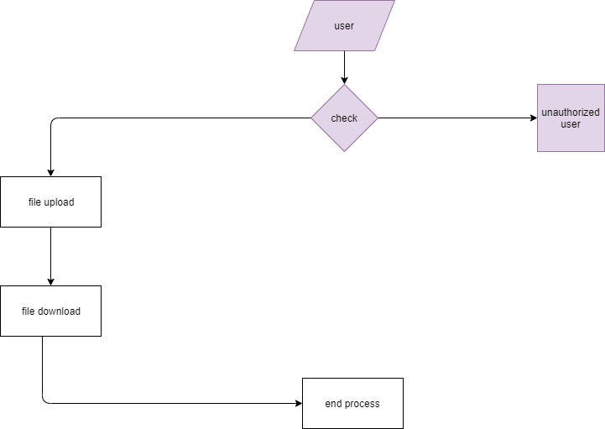

DATA FLOW DIAGRAMS
The above figures shows the data flow diagram of how user and admin logs in and how he gets access to database
TRR College of Engineering

Slide 18
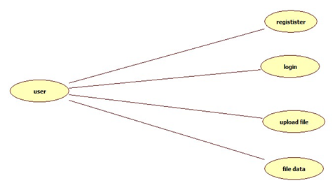
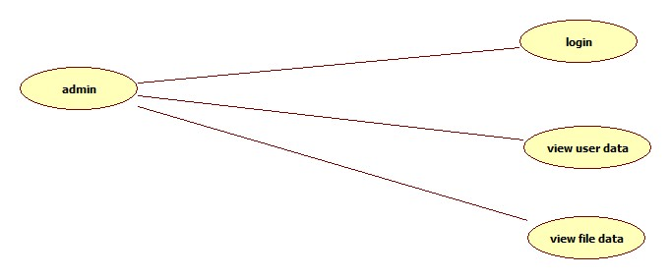
USE CASE DIAGRAMS
User
Admin
The above figures shows the use case diagram of the accessibilities of the user and admin
TRR College of Engineering

Slide 19
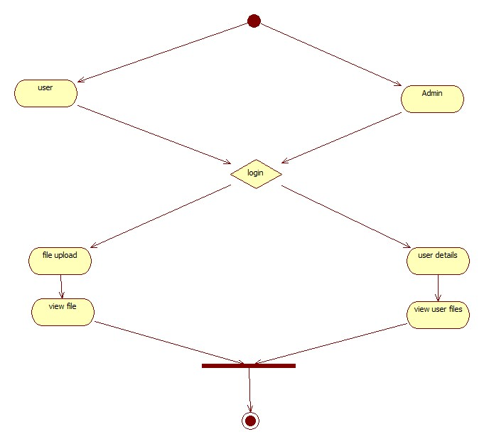
ACTIVITY DIAGRAM
The above figure shows the activity diagram of the activities of user and admin
TRR College of Engineering

Slide 20
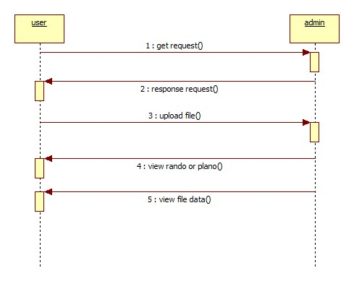
SEQUENCE DIAGRAM
The above figure shows the sequence diagram of request and response between user and admin
TRR College of Engineering

Slide 21
IMPLEMENTATION
TRR College of Engineering

Slide 22
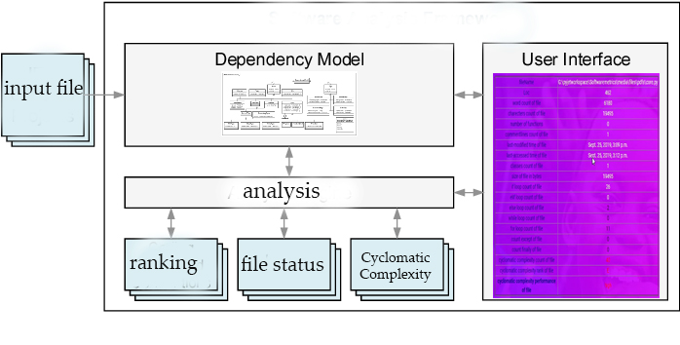
SYSTEM ARCHITECTURE
The above figure shows the architecture of the system of how the input file is taken as input, analyzed and result is given as output
TRR College of Engineering

Slide 23
TESTING
TRR College of Engineering

Slide 24
UNIT TESTING
Involves the design of test cases that validate that the internal program logic is functioning properly
It is the testing of individual software units of the application
INTEGRATION TESTING
Designed to test integrated software components to determine if they actually run as one program
Integration testing is specifically aimed at exposing the problems that arise from the combination of components
TRR College of Engineering

Slide 25
SYSTEM TESTING
Ensures that the entire integrated software system meets requirements
Configuration-oriented system integration test
WHITE BOX TESTING
Software tester has knowledge of the inner workings, structure and language of the software, or at least its purpose
It is used to test areas that cannot be reached from a black box level.
TRR College of Engineering

Slide 26
BLACK BOX TESTING
Black Box Testing is testing the software without any knowledge of the inner workings, structure or language of the module being tested
It also ensures that the system meets the functional requirements.
ACCEPTANCE TESTING
User Acceptance Testing is a critical phase of any project and requires significant participation by the end user.
It also ensures that the system meets the functional requirements.
TRR College of Engineering

Slide 27
TEST CASES
S.no | Test Case | Excepted Result | Result | Remarks (IF Fails)
1 | user registration | If user filled all form fields should be registered successfully. | Pass | If user is filled the form fields.
2 | ADMIN | user rights will be approved here. | Pass | If user is not registered.
3 | user LOGIN | If user name and password is correct then it will be getting valid page. | Pass | If user name or password is not correct.
4 | user upload code file | If user is correct then it will be getting valid page. | Pass | If user is not correct.
5 | Admin view | Admin can view user data. if admin id and password is correct.it will show valid page. | Pass | If admin is not correct.
6 | User view | If user is logged in then show analysis | Pass | If user is not logged in.
TRR College of Engineering

Slide 28
OUTPUT SCREENS
TRR College of Engineering

Slide 29
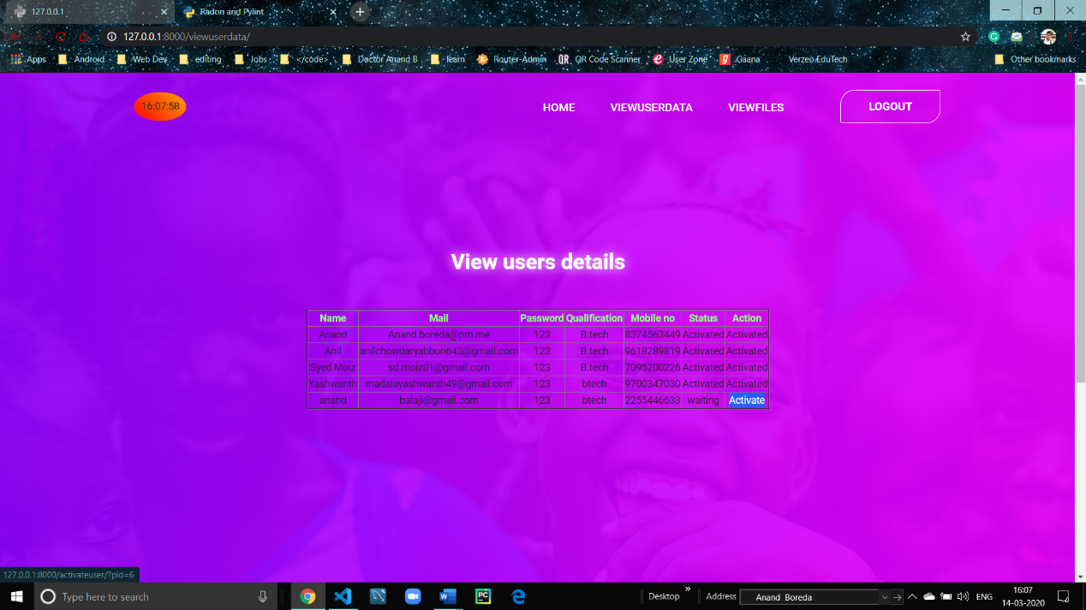
The Admin can look user’s credentials and authorize new users to gain access to database
TRR College of Engineering

Slide 30
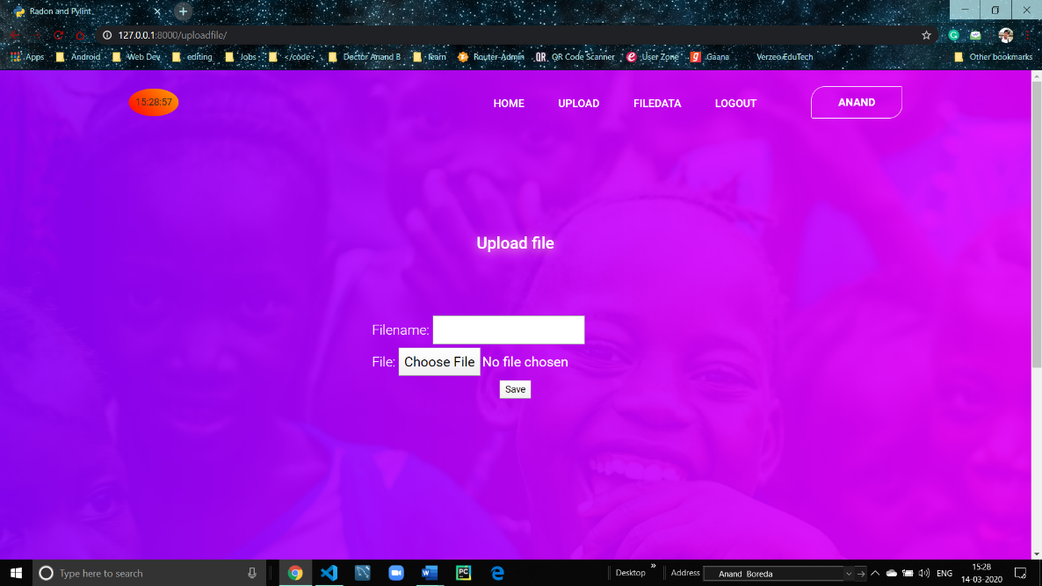
Authorized users can upload their code file or document to the database with a proper name attached to it.
TRR College of Engineering

Slide 31
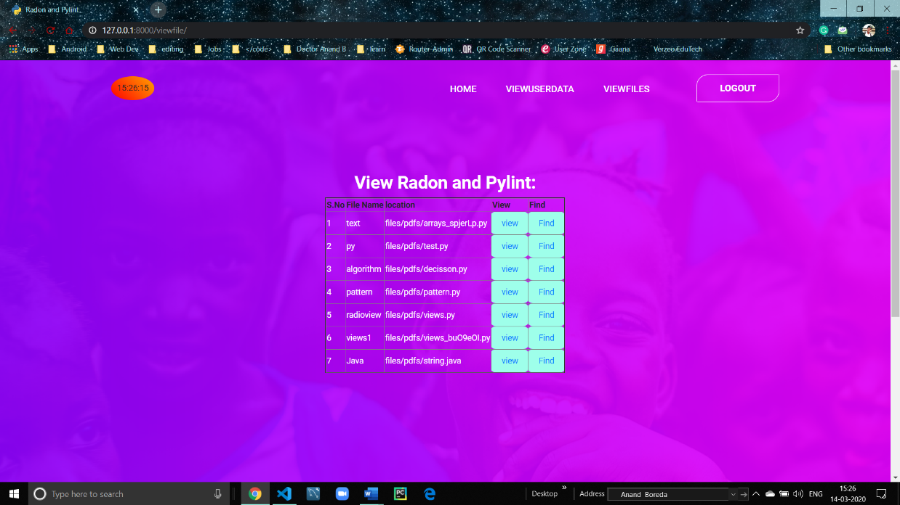
The Admin can look up the files or documents uploaded by the users to database
TRR College of Engineering

Slide 32
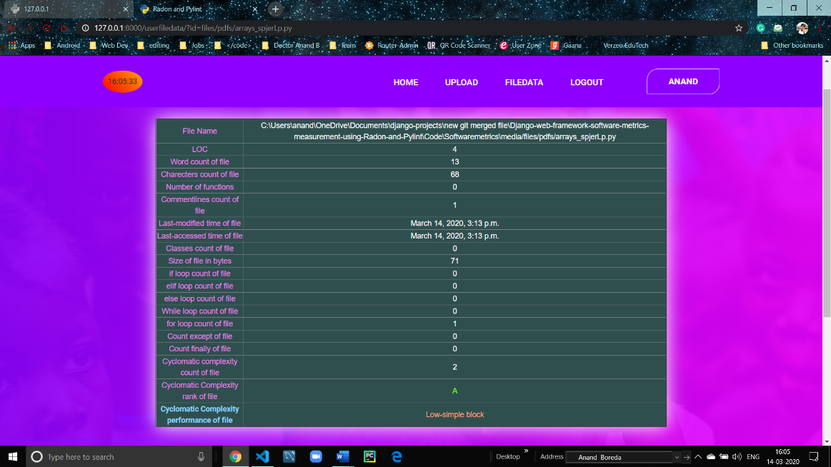
Whenever a user or admin requests to see the metrics of a specific file, he will be redirected to new page containing all the details and metrics of that specific document
TRR College of Engineering

Slide 33
CONCLUSION
In conclusion, this paper has measure Django Web Framework code quality metrics. Django option in the main directory has 2,200 lines of code, Cyclomatic Complexity score is 16.375 considered as moderate complexity, and 6.69/10 by the pylint score. With the same method, other web frameworks can be measured too.
TRR College of Engineering

Slide 34
FUTURE ENHANCEMENT
In future we are planning to provide an API (application programming interface). There is an idea to make this project ubiquitous by launching an API. We can actually do that using the Django REST Framework. Using the API, other authorized organizations can get access to our functionality what we are having now.
TRR College of Engineering

Slide 35
REFERENCES
D. P. Pop and A. Altar. (2014). Designing an MVC model for rapid web application development. Procedia Engineering, 69, 1172-1179.
M. Aniche, G. Bavota, C. Treude, M. A. Gerosa, and A. van Deursen, “Code smells for Model-View-Controller architectures,” Empir. Softw. Eng., vol. 23, no. 4, pp. 2121–2157, 2018.
S. Cass. (2017). The 2017 top programming languages. https://spectrum.ieee.org/computing/software/the-2017-topprogramming-languages. Accessed 18 October 2017.
A. Pelme. (2014). Evaluation of a web application architecture. (Dissertation). Retrieved from http://urn.kb.se/resolve?urn=urn: nbn:se:liu:diva-107011
R. Brown. (2015). Django vs. flask vs. pyramid: Choosing a python web framework. Recuperado el, 31.
P. Vogel, T. Klooster, V. Andrikopoulos, and M. Lungu, “A LowEffort Analytics Platform for Visualizing Evolving Flask-Based Python Web Services,” in 2017 IEEE Working Conference on Software Visualization (VISSOFT), 2017, pp. 109–113.

Slide 36
REFERENCES
Anonym. Tornado Python framework. http://www.tornadoweb.org/en/stable/
Hellkamp, M. (2017). Bottle: Python Web Framework. Available: https://bottlepy.org/docs/dev/. Accessed 28 October 2017.
S. Dasgupta and S. Hooshangi, “Code Quality: Examining the Efficacy of Automated Tools,” AMCIS 2017 Proc., Aug. 2017.
G. Farah, J. S. Tejada, and D. Correal, “OpenHub: A Scalable Architecture for the Analysis of Software Quality Attributes,” in Proceedings of the 11th Working Conference on Mining Software Repositories, 2014, pp. 420–423.
Y. Saleh. (2017). How does the django framework in python overcome the frameworks in PHP? https://www.egrovesys.com/blog/how-does-the-django-framework-inpython-overcome-the-frameworks-in-php/ Accessed 24 November 2017.
M. P. Malhotra and M. K. Shah. Python Based Software for Calculating Cyclomatic Complexity. (2015). International Journal of Innovative Science, Engineering and Technology, 2(3):546–549, March 2015.

Slide 37

THANK YOU
TRR College of Engineering

